Slide 1
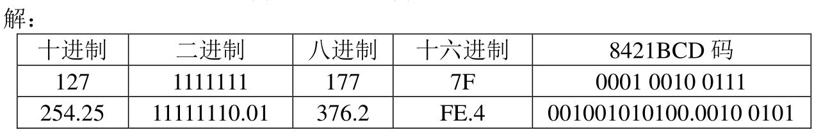
$${(1010.1011)}_{2}=1×2^{3}+0×2^{2}+1×2^{1}+0×2^{0}+1×2^{−1}+0×2^{−2}+1×2^{−3}+1×2^{−4}={(10.6875)}_{10}$$
$${(2E5.3)}_{16}=2×{16}^{2}+14×{16}^{1}+5×{16}^{0}+3×{16}^{−1}={(741.1875)}_{10}$$
$${(35.36)}_{8}=3×8^{1}+5×8^{0}+2×8^{−1}+6×8^{−2}={(29.34375)}_{10}$$

Slide 2
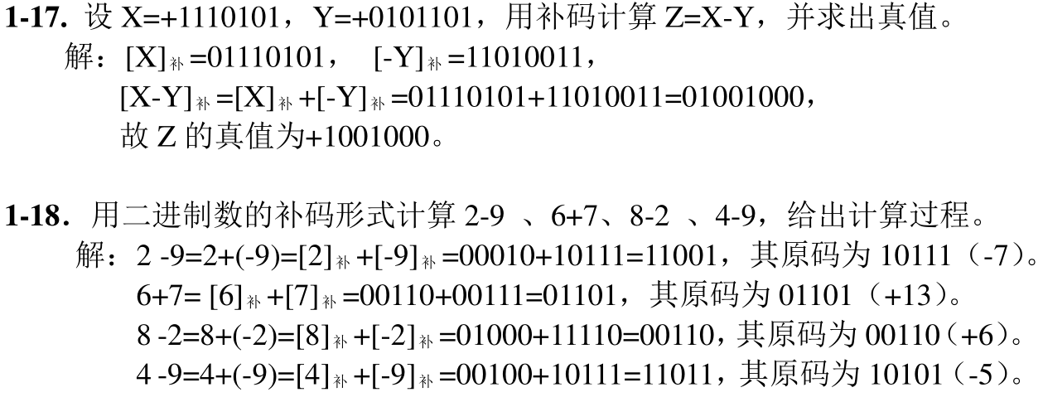

Slide 3
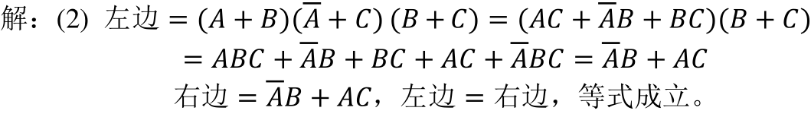
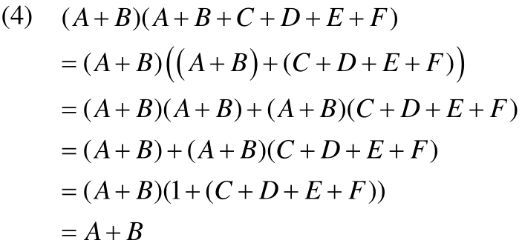

Slide 4
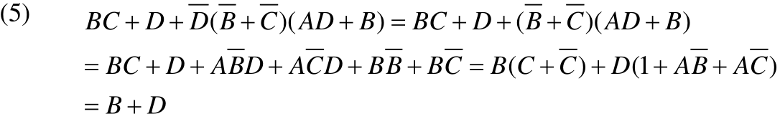



Slide 5
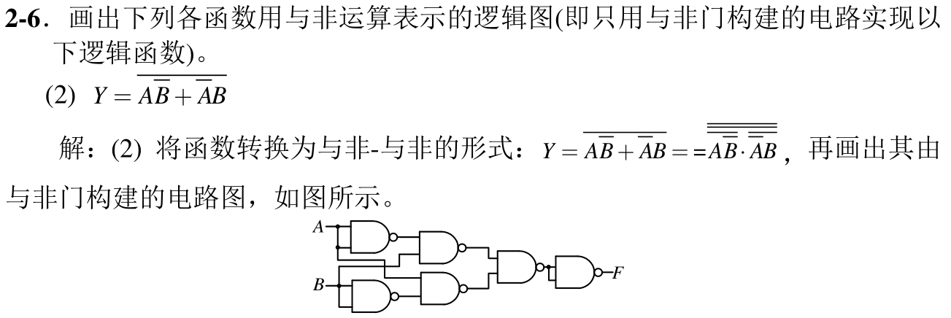

Slide 6

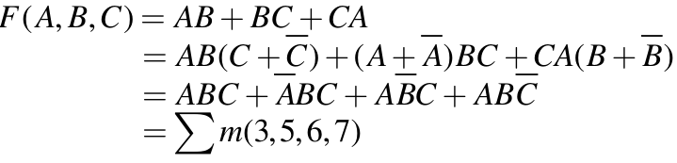

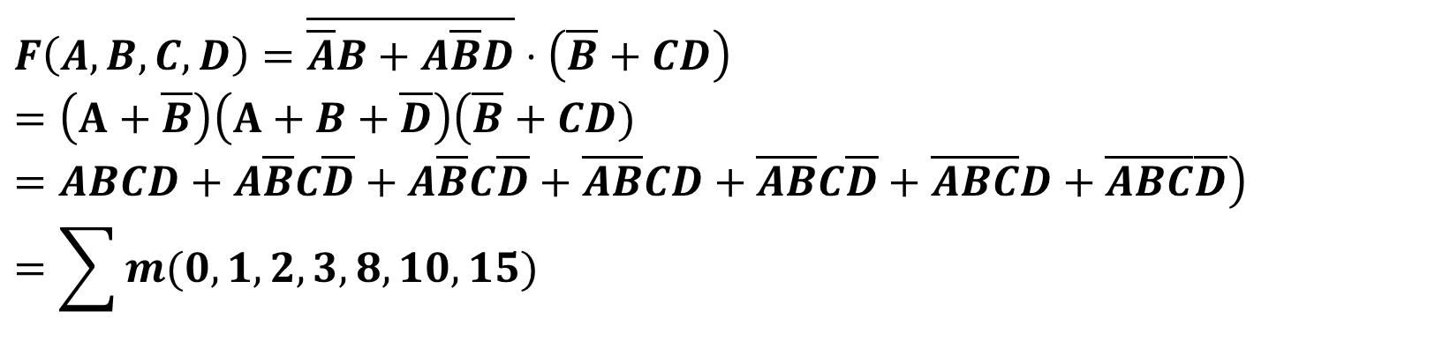
$$F\left(A,B,C,D\right)=\overline{\overline{A}B+A\overline{B}D}⋅\left(\overline{B}+CD\right)$$
$$=\left(A+\overline{B}\right)\left(A+B+\overline{D}\right)\left(\overline{B}+CD)=ABCD+A\overline{B}C\overline{D}+A\overline{B}C\overline{D}+\overline{A}\overline{B}CD+\overline{A}\overline{B}C\overline{D}+\overline{A}\overline{B}\overline{C}D+\overline{A}\overline{B}\overline{C}\overline{D}\right)$$
$$=\sum{m(0,1,2,3,8,10,15)}$$

Slide 7

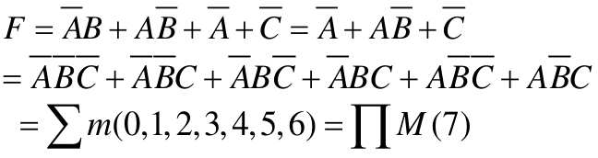

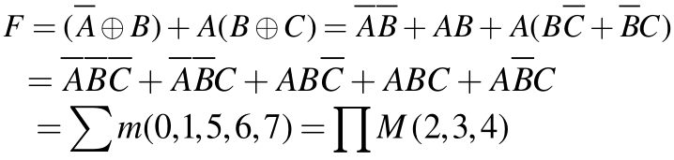

Slide 8


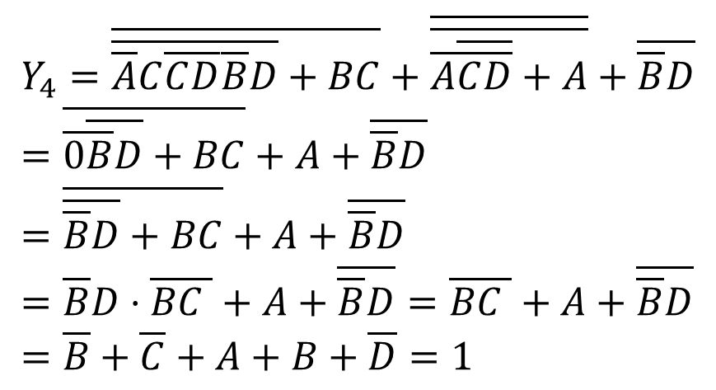
$$Y_{4}=\overline{\overline{\overline{A}C\overline{C}\overline{D}}\overline{\overline{B}D}+BC}+\overline{\overline{\overline{A}\overline{\overline{C}\overline{D}}+A}}+\overline{\overline{B}D}=\overline{\overline{0}\overline{\overline{B}D}+BC}+A+\overline{\overline{B}D}=\overline{\overline{\overline{B}D}+BC}+A+\overline{\overline{B}D}=\overline{B}D⋅\overline{BC }+A+\overline{\overline{B}D}=\overline{BC }+A+\overline{\overline{B}D}=\overline{B}+\overline{C}+A+B+\overline{D}=1$$

Slide 9
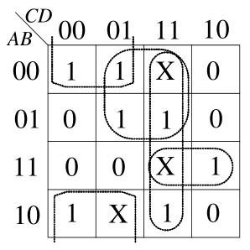


Slide 10
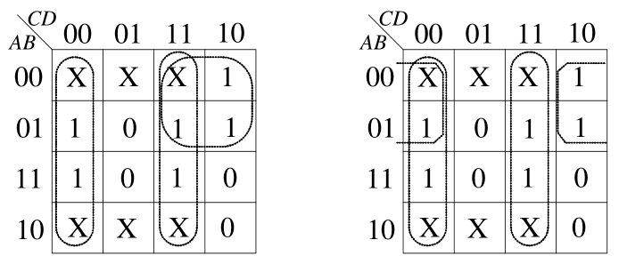
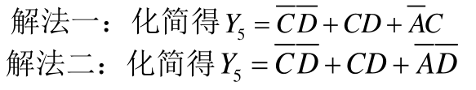

Slide 11
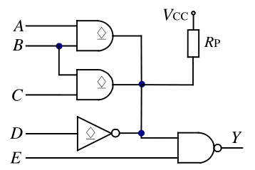

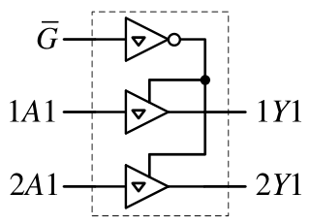


Slide 12
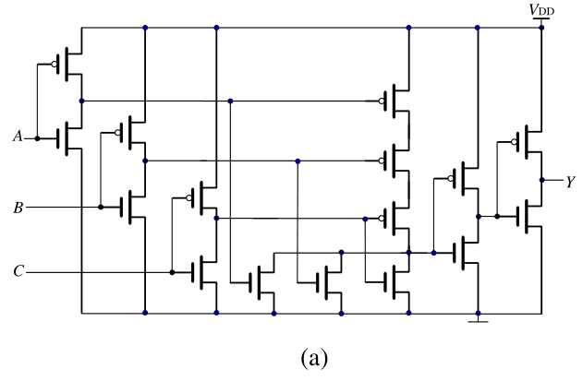

Slide 13
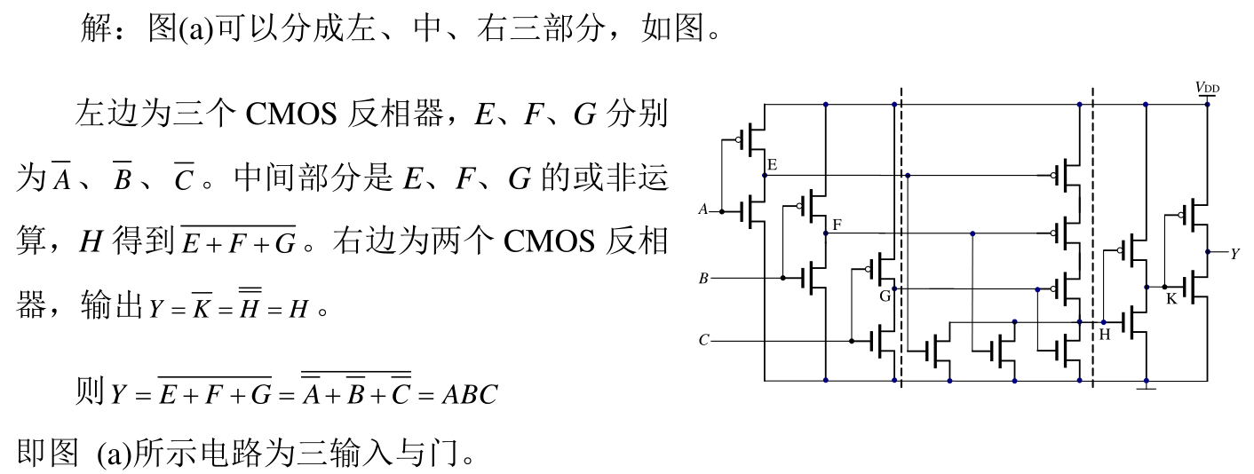

Slide 14
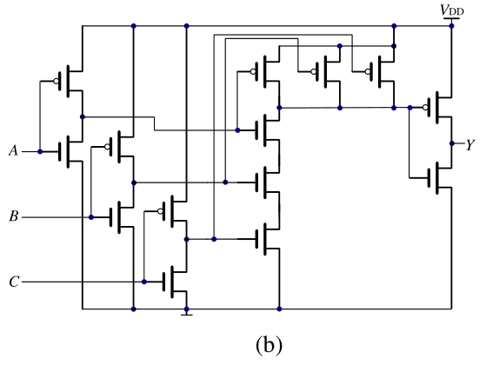

Slide 15
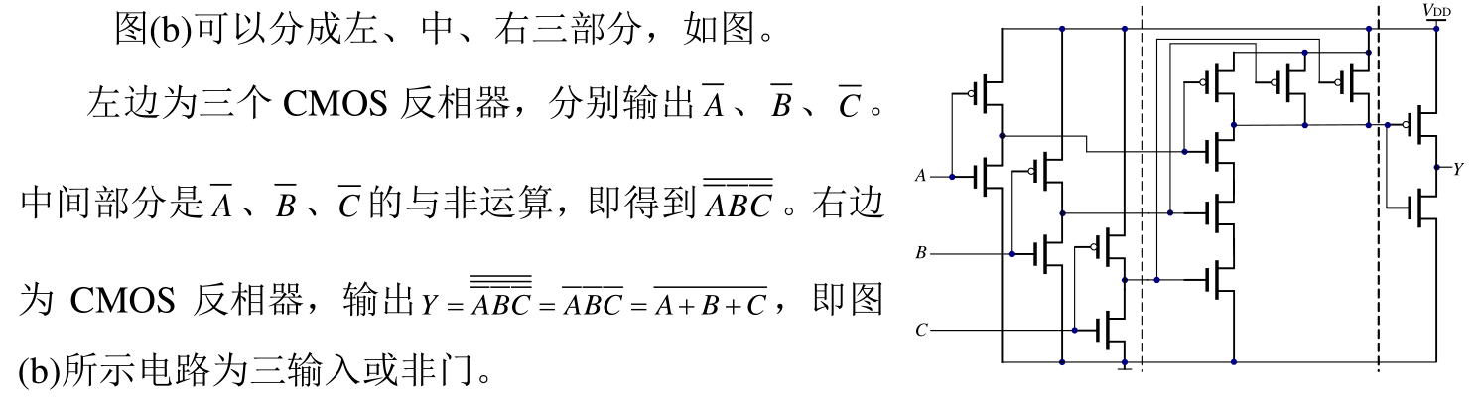

Slide 16
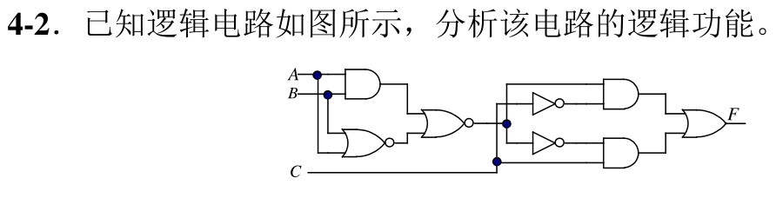
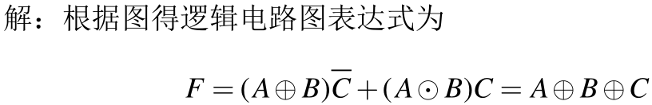
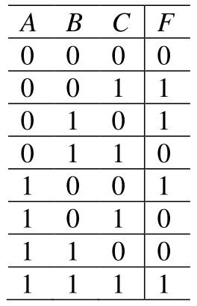


Slide 17
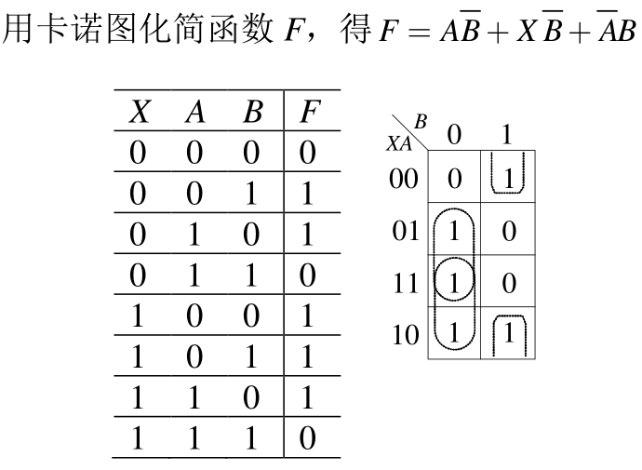

Slide 18
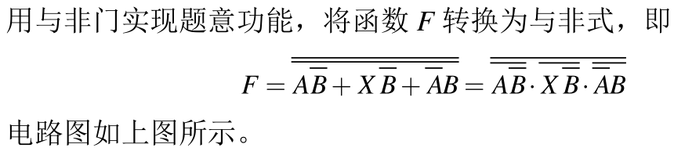
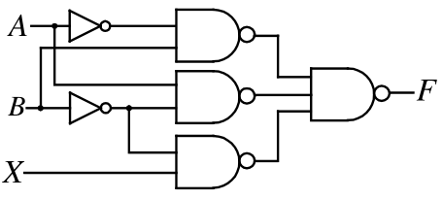

Slide 19
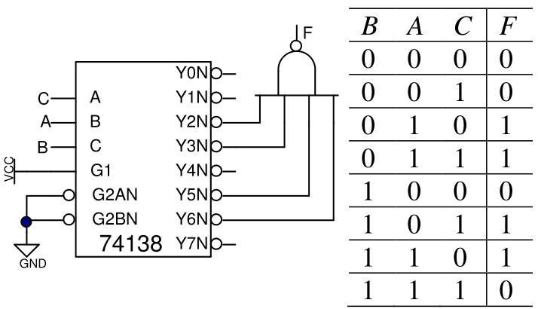

Slide 20
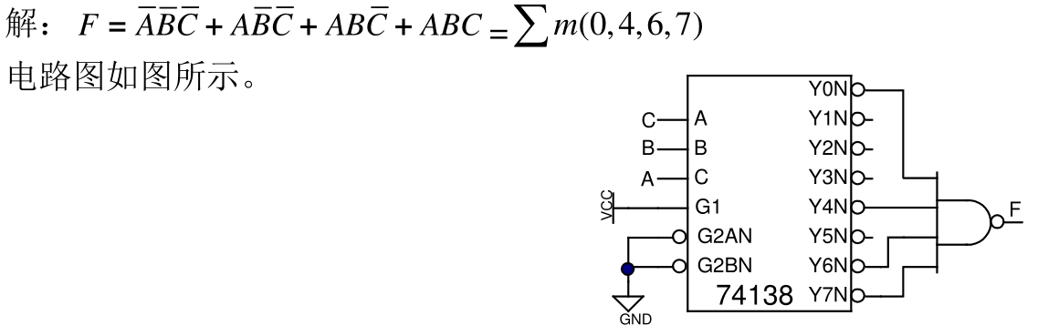

Slide 21
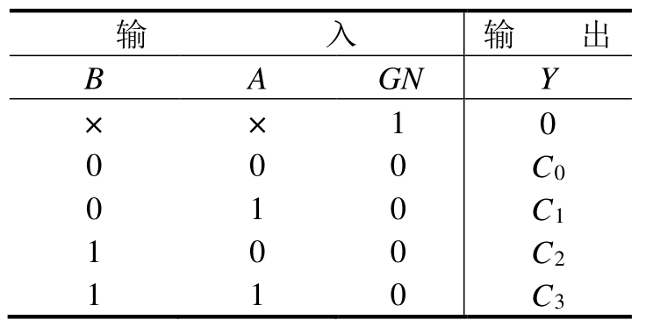
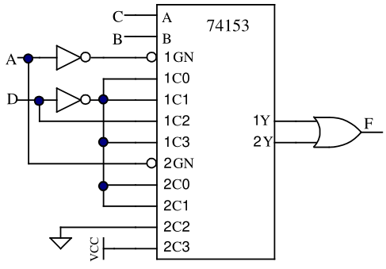
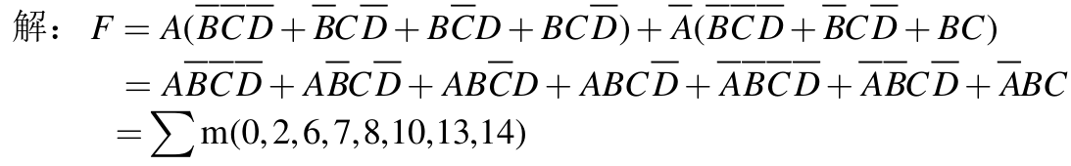

Slide 22
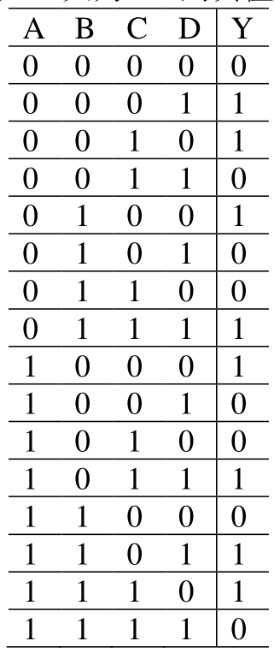
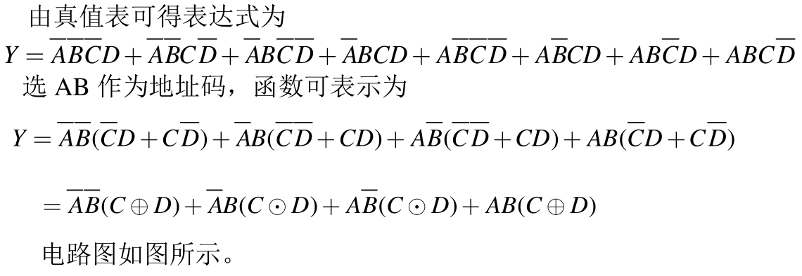
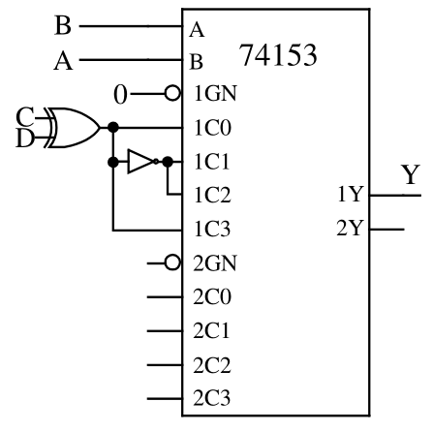

Slide 23

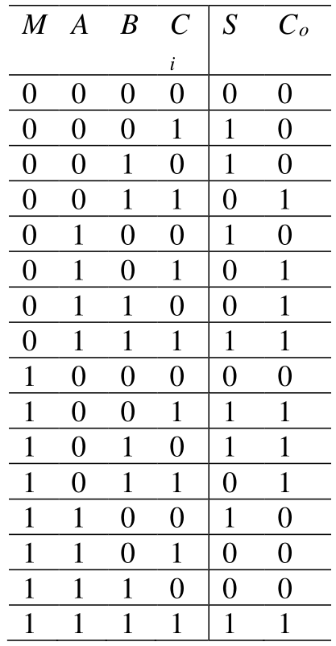
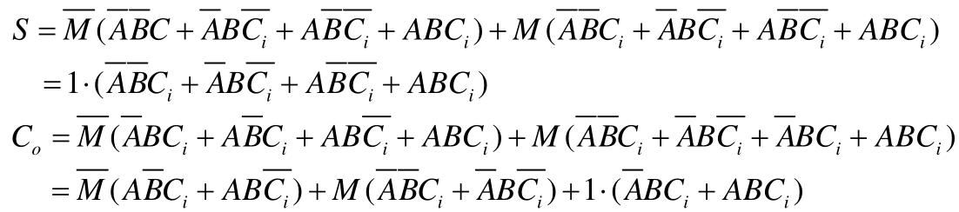

Slide 24
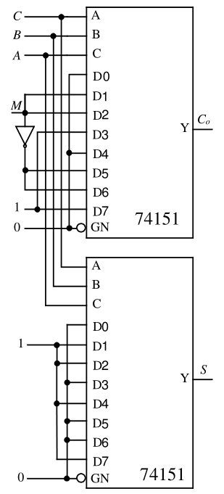

Slide 25
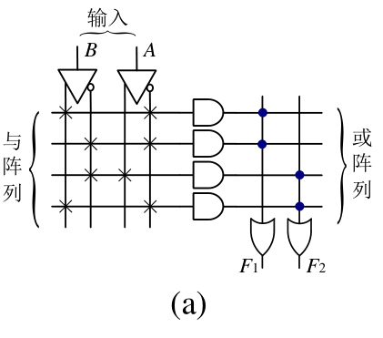

Slide 26
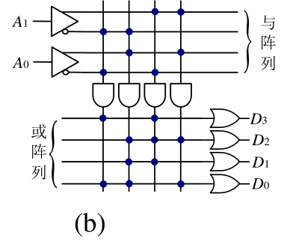

Slide 27
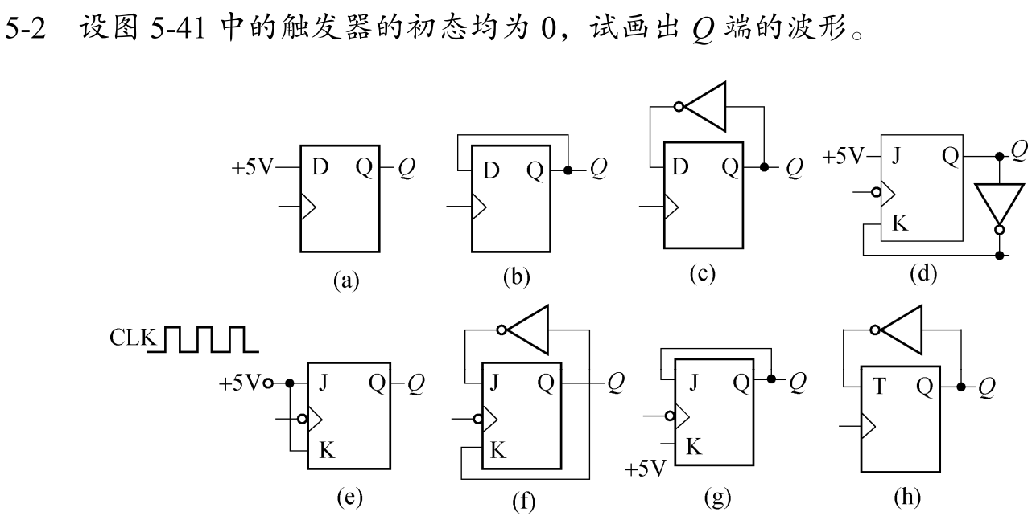

Slide 28
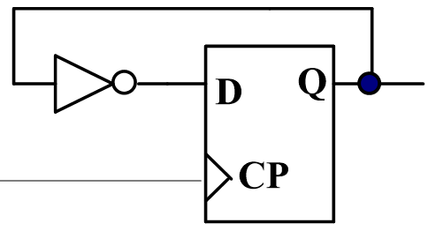
+5V
D
Q₁
CP
CP
上升沿
C1
Q₁
(a)
Q₁
D
Q₂
CP
C1
Q₂
Q₂
(b)
Q₃
Q₃
(c)

Slide 29
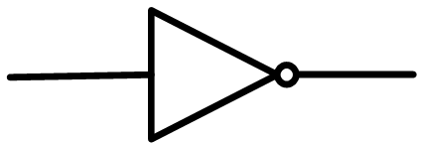
+5V
J
Q₄
CP
CP
下降沿
C1
K
Q₄
+5V
J
Q₅
CP
C1
Q₅
K
Q₆
J
Q₆
CP
C1
Q₇
K
J
Q₇
CP
C1
+5V
K

Slide 30
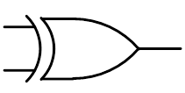
CP
T
Q₈
上升沿
Q₈
1
CLK
下降沿
J
S
Q
B
CP
A
C1
B
A
K
Q

Slide 31
C
CLK
下降沿
A
J
R_{D}
Q
A
CP
C1
B
K
Q
C
B
Q

Slide 32
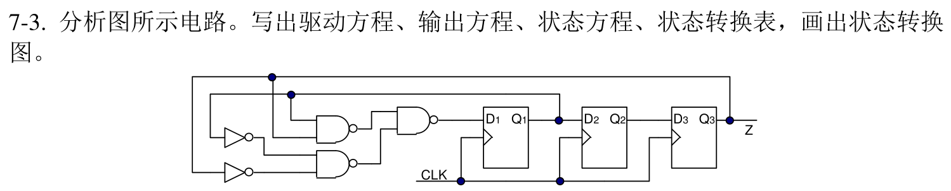











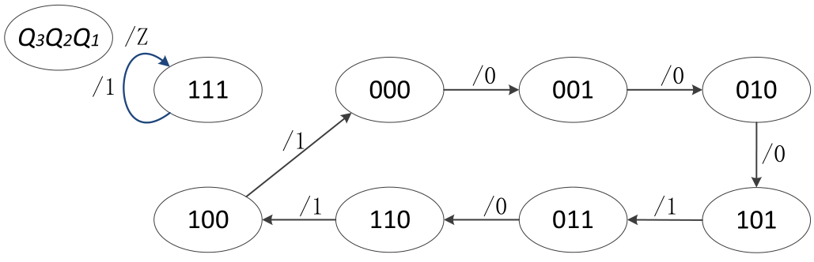
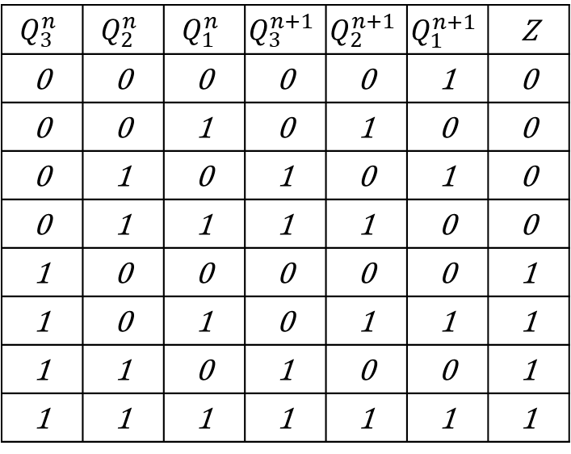
$$Q_{3}^{n}$$ | $$Q_{2}^{n}$$ | $$Q_{1}^{n}$$ | $$Q_{3}^{n+1}$$ | $$Q_{2}^{n+1}$$ | $$Q_{1}^{n+1}$$ | Z
0 | 0 | 0 | 0 | 0 | 1 | 0
0 | 0 | 1 | 0 | 1 | 0 | 0
0 | 1 | 0 | 1 | 0 | 1 | 0
0 | 1 | 1 | 1 | 1 | 0 | 0
1 | 0 | 0 | 0 | 0 | 0 | 1
1 | 0 | 1 | 0 | 1 | 1 | 1
1 | 1 | 0 | 1 | 0 | 0 | 1
1 | 1 | 1 | 1 | 1 | 1 | 1

Slide 33
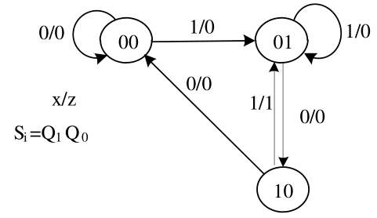








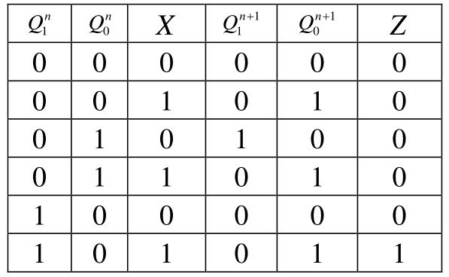
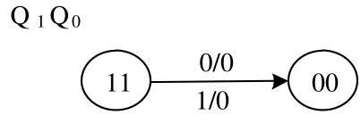

Slide 34
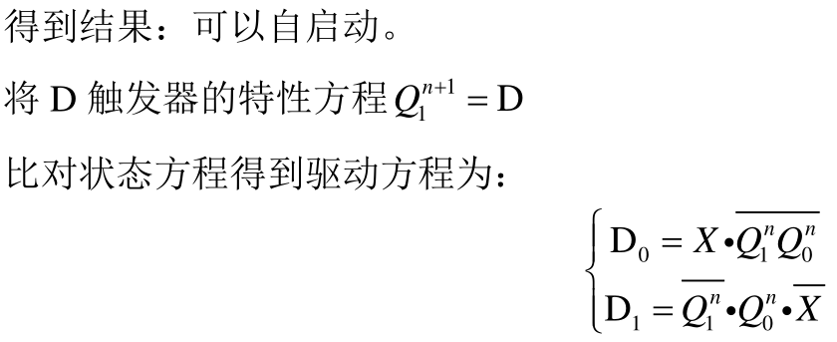


Slide 35











4
$$X$$ | $$Q_{1}^{n}$$ | $$Q_{0}^{n}$$ | $$Q_{1}^{n+1}$$ | $$Q_{0}^{n+1}$$ | Y₀ | Y1
0 | 0 | 0 | 0 | 1 | 0 | 0
0 | 0 | 1 | 1 | 0 | 0 | 0
0 | 1 | 0 | 0 | 0 | 1 | 0
0 | 1 | 1 | X | X | X | X
1 | 0 | 0 | 0 | 1 | 0 | 0
1 | 0 | 1 | 1 | 0 | 0 | 0
1 | 1 | 0 | 1 | 1 | 0 | 0
1 | 1 | 1 | 0 | 0 | 0 | 1
M/Y₁Y₀
$$Q_{1}^{n}Q_{2}^{n}$$
0/00
1/00
01
00
0/01
0/00
1/00
1/10
$K_{1}=\overline{x}$+$Q_{0}$
11
10
1/00

Slide 36


Slide 37




Slide 38

计数顺序
计 数 器 状 态
预置数：1010
Q₃
Q₂
Q₁
Q₀
0
0
0
0
0
0
1
0
0
0
1
1
2
0
0
1
0
0
3
0
0
1
1
1
4
0
1
0
0
5
0
1
0
1
6
0
1
1
0
7
0
1
1
1
/Z
8
1
0
0
0
/0
/0
9
1
0
0
1
Q_{D}Q_{C}Q_{B}Q_{A}
1010
1011
1100
10
1
0
1
0
11
1
0
1
1
/0
/1
12
1
1
0
0
/0
13
1
1
0
1
/0
1111
1110
1101
14
1
1
1
0
15
1
1
1
1
16
0
0
0
0

Slide 39



Slide 40



Slide 41




Slide 42
需要8片

Slide 43


$$V_{0}=−\frac{V_{REF}R_{F}}{2^{n}R}\left(\sum_{i=0}^{n−1}{2^{i}d_{i}}\right)=−\frac{8}{2^{4}}\left(2^{0}∙1+2^{1}∙1+2^{2}∙0+2^{3}∙1\right)=5.5 V$$

